Slide 1
Gardening for Wildlife: Naturescaping Fundamentals
Part 1: Creating Habitat at Home
March 17 and March 24, 2021
Suzi Cloutier ~ Anya Pickard ~ Morgan Parks ~ Lisa Kilders ~ Kristina Peterson ~ Nicole Ahr
Notes:
Introduce presenters and organizations

Slide 2
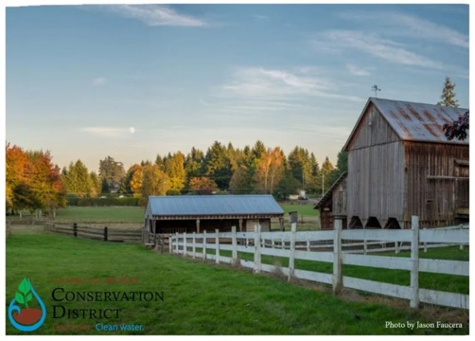
Welcome!
While we wait for attendees to join, please write in the chat:
Where you’re joining from
Are you growing anything fun?
What do you hope to learn tonight?
Notes:
Where are you all from?
What is your watershed?
Favorite thing about your yard? Least Favorite thing about your yard?
Are we going to share basic Zoom instructions?

Slide 3
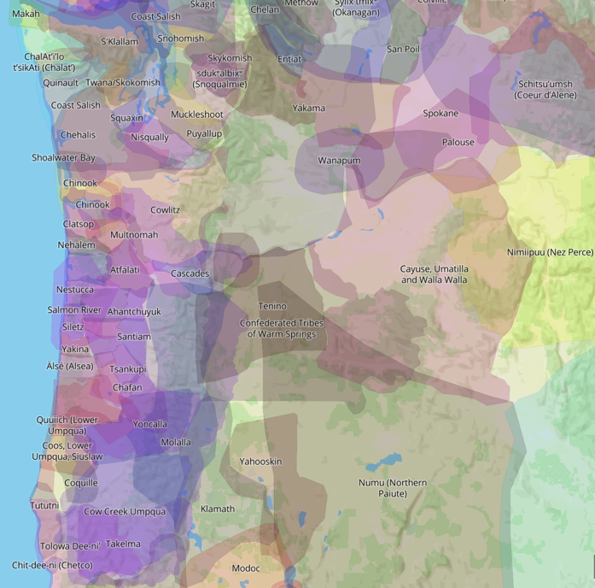
Notes:
Many of us are joining this call from Oregon and Washington, and I’d like to take a moment to recognize that we are gathered on the unceded land of many Native Peoples. I ask you to join me in acknowledging the many communities, their elders both past and present, as well as future generations. This acknowledgement demonstrates a commitment to beginning the process of working to dismantle the ongoing legacies of settler colonialism. We thank those who came before us for their stewardship of these lands and waters and those who continue to steward them now and in the future.

Slide 4
Zoom Etiquette
Leave your microphone off
You can leave your camera off too!
Write your questions into the chat and we’ll address them
Notes:
Where are you all from?
What is your watershed?
Favorite thing about your yard? Least Favorite thing about your yard?
Are we going to share basic Zoom instructions?

Slide 5
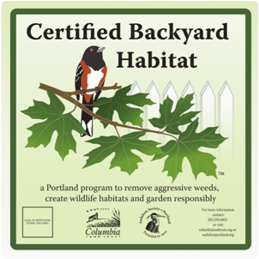
Backyard Habitat Certification Program
Since 1902, promoting the understanding, enjoyment, and protection of native birds, other wildlife and their habitats.
Mission: Conserve and care for the vital lands, waters, and wildlife of the Columbia River region through sound science and strong relationships.
Notes:
Anya The BHCP exists within both parent organizations’ goals:
· From a habitat-restoration perspective, yards are effectively expanding the size and value of anchor habitats in the city – we are creating corridors of biodiversity.
· From an advocacy perspective, we’re connecting people to their yards – but more importantly to the role their yards play in the urban landscape and the role they, as individuals, can play in broader conservation initiatives.

Slide 6
Clackamas River Basin Council
“ We foster partnerships for clean water and to improve fish and wildlife habitat and the quality of life for those who live, work and recreate in the watershed.”
Notes:
Suzi -stewardship and Outreach manager. I would also like to thank our Communications and Program Coordinator for keeping this new fangled way of teaching working well for all of us.
We foster parnterships…...
We accomplish this by:
Undertaking watershed restoration to increase the abundance, diversity, and productivity of native resident and anadromous (salmon and steelhead) fish populations throughout the basin.
Protecting and enhancing the quality and quantity of source water for domestic water supplies to meet an increasing population.
Controlling non-native weeds, and restoring native vegetation to improve both aquatic and terrestrial habitats.
Public Education
The Council is currently working hard to sample for pesticieds in the basin and working with the SWCD to create a strategic Plan for pesticide users, We are creating new side channels and large wood structures in the river and it tribs to ensure healthy spawning and rearing habitat for our 5 endangered and threatened species of Salmon and Steelhead, We have planted well over 50 miles of riparian forests

Slide 7
Clackamas Soil and Water Conservation District
Notes:
Lisa or Nicole

Slide 8
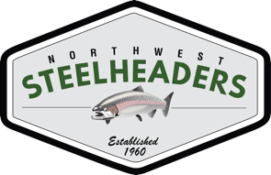
National Wildlife Federation &
Association of Northwest Steelheaders
“A Voice for Wildlife”
80+ years old – established 1936
6 million members – largest grassroots conservation organization in US
51 state affiliates make up the Federation
Oregon affiliate partner is Association of Northwest Steelheaders
Oregon focus: Education and Advocacy
(Salmon and monarch conservation, Garden for Wildlife, Eco-Schools USA)
Notes:
Morgan and Kristina
Mission - To unite all Americans in ensuring wildlife thrive in a rapidly changing world.
Known for our Guardian of the Wild Ambassador - Ranger Rick

Slide 9
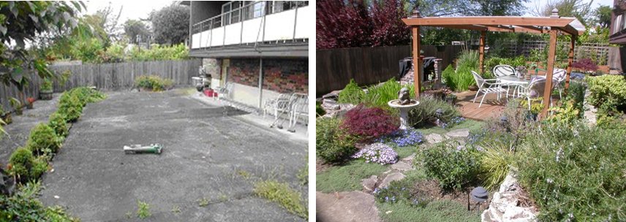
The Problem
TURN THIS … INTO … THIS!
Notes:
Suzi
Over the next two weeks, we are going to help you make not only a beautiful yard but a healthy, persitivde free, wildlife friendly, no water, puddle free yard.
Or as the author Douglas Tallemy says “Bringing Nature Home”
The story of humans and our surroundings is not a pretty one but with more knowledge and more power to change the way we see and be in the world, each of our little changes will change the world.

Slide 10
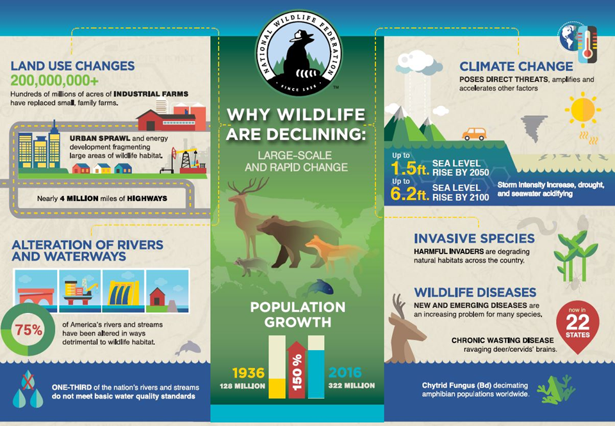
Wildlife are declining
Notes:
Suzi -
There are a LOT of things leading to wildlifes decline. Invasive Species, urban sprawl, climate change, human population growth the way we use our land.
Should we be afraid? Yes. Are there things that we can do? HECK YES!
Lets just start with birds for one, since well know and love them.
25% of our Common bird Species are in decline.
As a matter of fact, many of our common bird species alone have lost 50% of their former numbers in the last 40 years!
Barn swallows
American Goldfinches
Rufus Hummingbirds
Flycatchers
Orange Crown Warblers
Golden Crowned Kinglets
Wester nmeadowlark (our state bird)
Killdeer
Mourning Doves
House Wrens
I won’t even start with our insects, fish and mammals species….
What is causing these declines? Not one thing but LOTS of things add up! For birds alone and the area JUST in our yards: Loss of habitat, Climate Change, Manmade hazards like cats and windows. Lack of food and shelter.

Slide 11
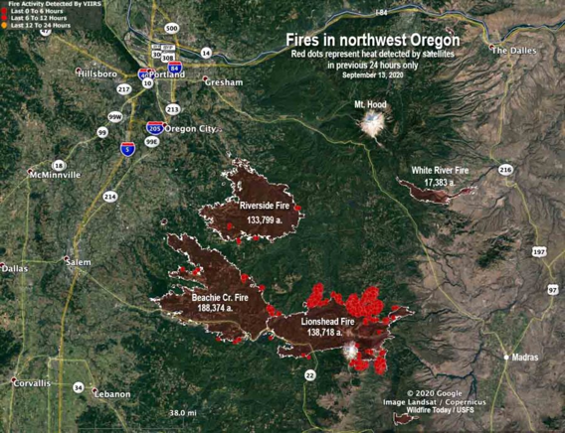
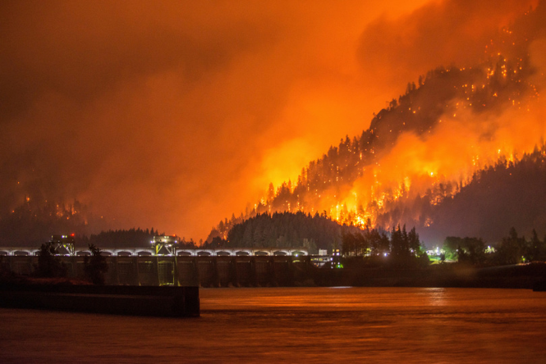
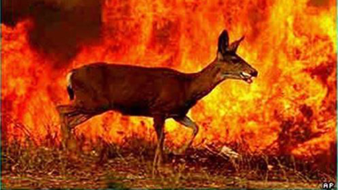
And Lets not forget more recent events
Notes:
Suzi-
Getting more local-
The Riverside Fire in the Clackamas burned more than 138,000 acres alone. Combined with the Lionshead and Beachie fires, the total area burned in 2020 with just the three fires was 542,000 acres of habitat destroyed in the span of just three weeks! . (138,000+200,000+204,000)
Think about it, in just one catastrophic event, we can lose over a half of a million acres of wildlife habitat along with much of the wildlife that depends on it.

Slide 12
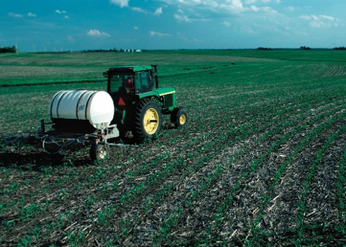
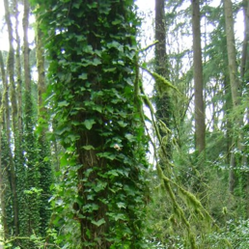
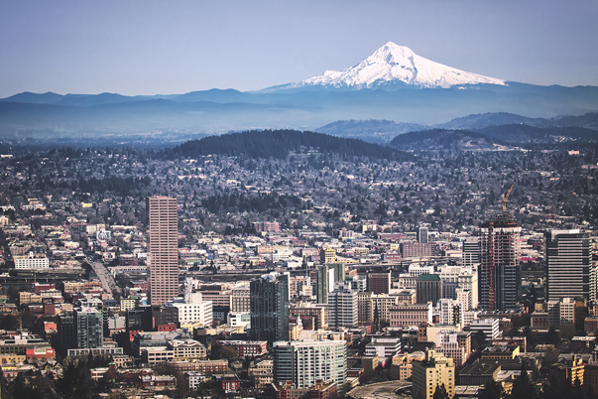
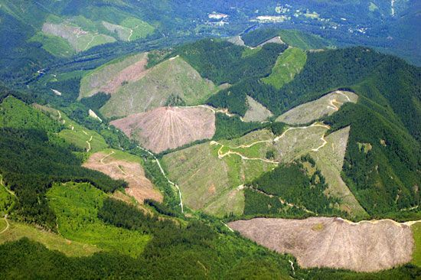
It All Adds Up
Notes:
Suzi
We live in such a beautiful area of the country. From large mountains, high desert, coast, wetlands, etc..
The Portland-Vancouver region sits at an incredible ecological crossroads – the confluence of two great rivers – north, south, east, and west migration routes for migratory animals.
Stretching our human inhabitation out a bit……
This country has 43 million acres of LAWN!
While only 1-3% of the ENTIRE US is considered ‘undisturbed’- Yike!
Te rapid conversion of natural lands to cement-dominated urban centers is causing great losses in biodiversity.
Yet, according to a new study involving 147 cities worldwide, surprisingly high numbers of plant and animal species persist and even flourish in urban environments -- to the tune of hundreds of bird species and thousands of plant species in a single city.
University of California, Santa Barbara
e rapid conversion of natural lands to cement-dominated urban centers is causing great losses in biodiversity.
Yet, according to a new study involving 147 cities worldwide, surprisingly high numbers of plant and animal species persist and even flourish in urban environments -- to the tune of hundreds of bird species and thousands of plant species in a single city.
University of California, Santa Barbara

Slide 13
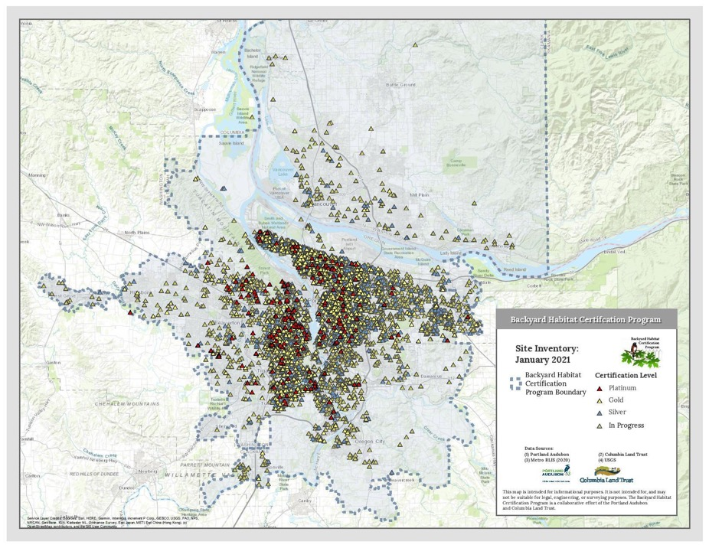
Notes:
ANYA -
If you think that your one little bitty yard won’t make a difference, then let me show you how much habitat has been created with many ‘little bitty yards’ participating! Just with PDX/Vancouver residents participating in BYHP alone, that is X acres of contiguous habitat in the middle of the city and suburbs in the PDX metro area. Now how many more will you have with folks participating in WFS programs? Or enrolled in NO programs?!
(Morgan stat) Speak to the fact that NWF also has 741 Certified Wildlife Habitats in Portland (60 of which are Schoolyard Habitats) participating and there are MANY folks who are not involved in any program.
It all adds up!

Slide 14
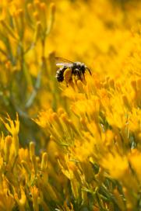
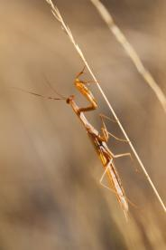
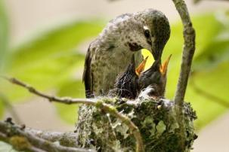
Why does naturescaping my yard even matter?
367 Species of birds and other wildlife call our region home
Notes:
Suzi - but hold on, this is NOT all doom and gloom. There IS hope. Nature IS resilient- especially when we give it a nudge.
”though we traditionally think of our urban landscapes devoid of biodiversity, studies find hundreds of bird species and thousand of plant species didn’t just survive in cities but actually thrived when the correct resources were provided.”
If you take just ONE THING away from this class, I would like it to be this small fact:
Our native wildlife have co evolved to utilize our native plants. What that means is that around 98% of a native plant is utilized in some way (food, shelter, breeding, rearing etc) by our native wildlife.
But only 2-5% of our cultivars (those plants we buy from the nursery that ‘ain’t from around here’) can be utilized by our native wildlife. Lush wonderful looking yards can be utter biological wastelands for our native wildlife and pollinators.
If we wonder why our yards are really serving all the important native critters well (from bugs to birds to mammals), remember these stats.
Maybe there is one other thing that I would like you to take from this class- YOU CAN BE THE SOLUTION. SERIOUSLY. Just one person doing just one thing adds up to BIG THINGS. I will let Anya share the proof!

Slide 15
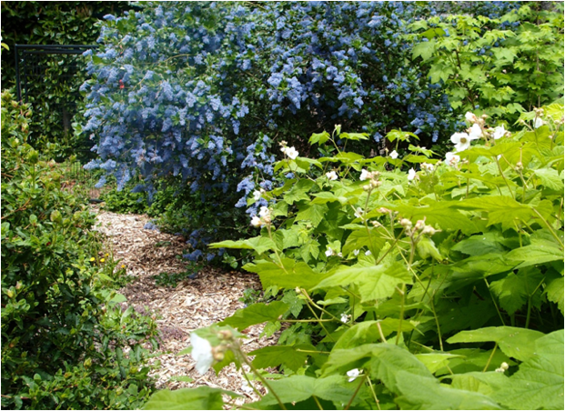
Gardening Solutions
Urban biodiversity is not an oxymoron.
In the past, we have asked one thing of our gardens: that they be pretty. Now they have to support life, sequester carbon, feed pollinators and manage water.”
Douglas Tallamy, University of Delaware
Notes:
Anya

Slide 16
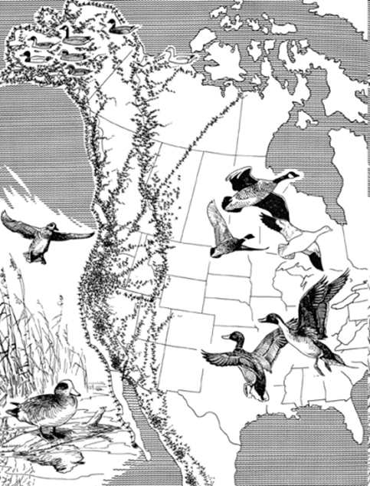
Corridors and Migration
Pacific Flyway
Notes:
Anya: The Pacific Flyway is a major north-south flyway for migratory birds in America, extending from Alaska to Patagonia. Every year, migratory birds travel some or all of this distance both in spring and in fall, following food sources, heading to breeding grounds, or travelling to overwintering sites.So we can’t just pretend there isn’t or doesn’t need to be wildlife habitat in our more developed communities.
Lets go back to those native plants again- Many of these birds eat insects that are reared on our native plants.
An intact native Streamside does a stellar job of holding soil erosion and filtering pollutants while a grassy ‘parklike’ streamside will only do 10% or less of this job.

Slide 17
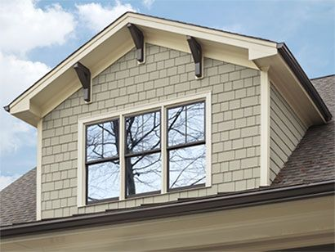
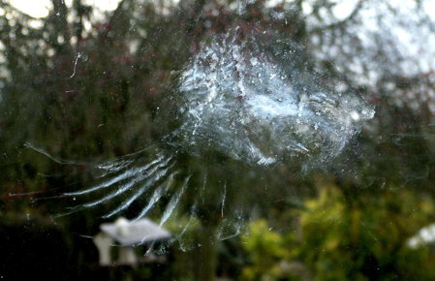
Challenges
More than 100 million birds die in strikes every year
At night, migrating birds and moths are disoriented by night lights which leads to window collisions
Bird-Friendly Building guidelines
“Lights Out Portland”
Notes:
Anya
More than 100 million birds die in strikes every year
Bird strike windows
Silhouettes
Lights out/ no front door/ vapor lights
Moths migration disrupted by light creating false horizons
Motion sensor lights
Night lighting is a Human health issue as well

Slide 18
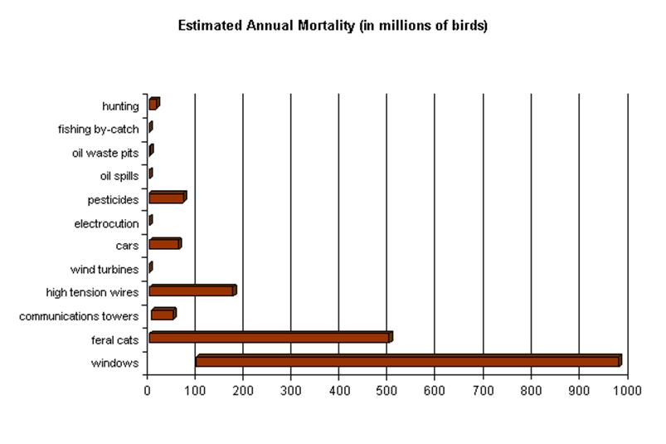
Notes:
Anya
If we want to know that gravity of the problem- here is a little detail on what is really going on out there. This is in MILLIONS of birds annually!

Slide 19
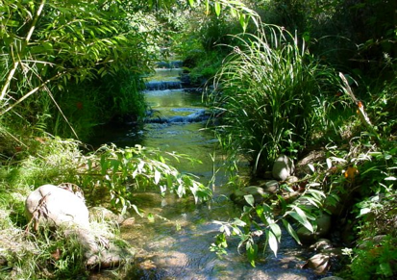
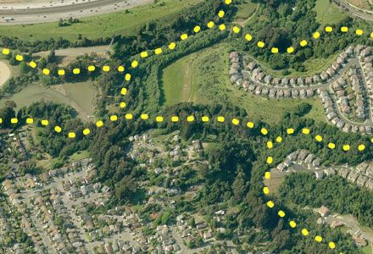
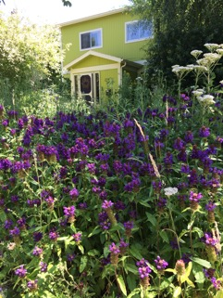
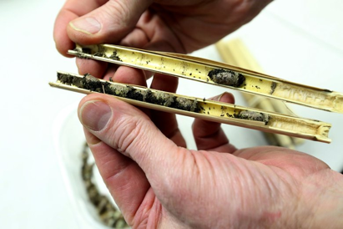
Other Corridors We May Not Think About
Notes:
Anya
Keep in mind that wildlife utilize MANY corridors
From our highway system to local roads, alleyways, and utilize LOTS of different heights to move around and utilize

Slide 20
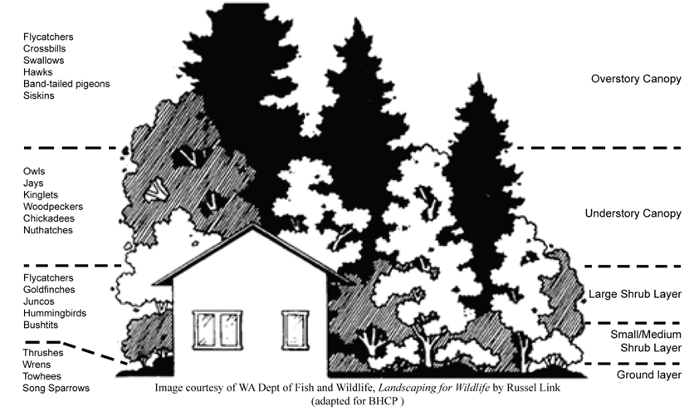
More Layers = More Wildlife Diversity
Notes:
Anya
Heights of trees also corresponds to roots underground holding the soil.
Lots of canopy layers- lots of wildlife, lots of soil that stay put.
60% of our songbirds live in the shrub layer

Slide 21
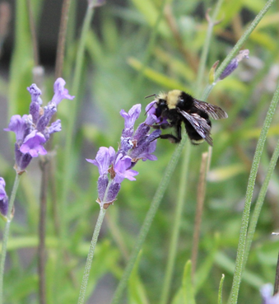
Elements of Habitat
Food
Water
Cover/Shelter
Places to Raise Young
Notes:
Kristina Slide 18 - 34

Slide 22
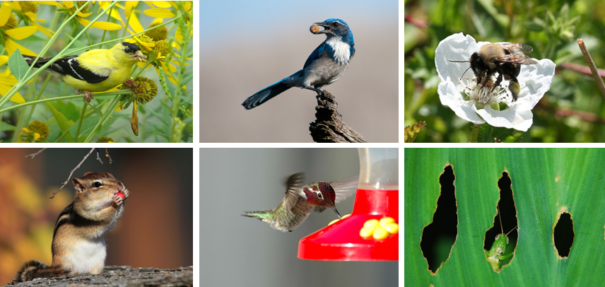
Food
Notes:
Kristina- The most important way to offer food is through native plants (seeds, berries, nuts, foliage, pollen, and nectar)
-75% of flowering plants require animal pollinators in order to successfully reproduce
-Animals digest edible parts, pass seeds through digestive tracts, and deposit them far away from parent plant, where they are ready to germinate
-20-30% of native bee species only collect pollen to provision young from certain plants

Slide 23
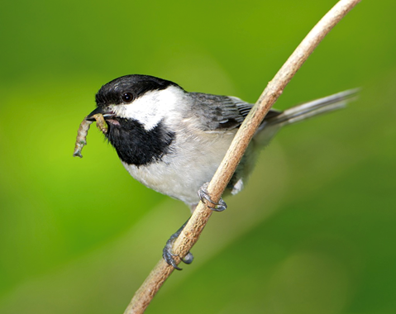
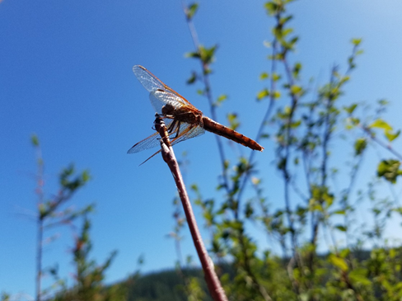
Food: Invertebrates
96% of terrestrial birds rely on invertebrates to feed their young.
Notes:
Kristina
-Birds need more than just plants to survive.
-90% of insects that feed on plants can only survive on those that are native to the region
-96% of terrestrial birds rely on invertebrates to feed their young
-Moth caterpillars, spiders, and crickets are most important invertebrates for birds
-How do you attract invertebrates? Fill your garden with native plants and avoid pesticides

Slide 24
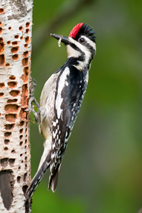
Food Sources
Remember:
Native plants are the best source of food!
What food sources do I need?
Plants or supplemental feeders to consider:
Seeds from a plant
Berries
Nectar
Foliage/Twigs
Nuts
Fruits
Sap
Pollen
Suet
Bird Feeder
Squirrel Feeder
Hummingbird Feeder
Butterfly Feeder
Notes:
Kristina
-Remember to provide a mix of plants and food sources for all 4 seasons
-While the best way to provide food for wildlife is to preserve and restore local native plant communities, you can use various feeders as supplemental food sources

Slide 25
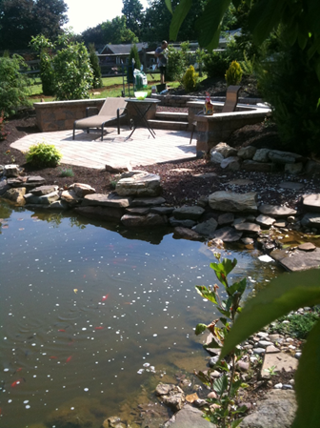
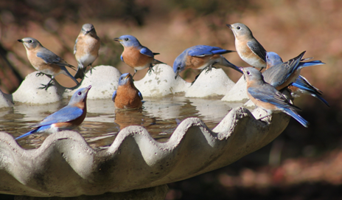
Water
All animals need water to drink, bathe, or live in.
Notes:
Kristina
-All wildlife species need water for drinking and birds need water for bathing as well
-Without water for birds to bathe, their feathers become dirty and flight is difficult
-Water can also provide cover for wildlife, reproduction space, and place to raise young
-

Slide 26
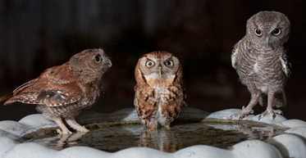
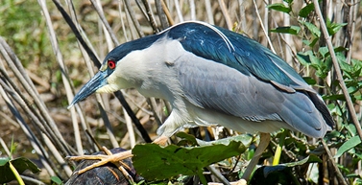
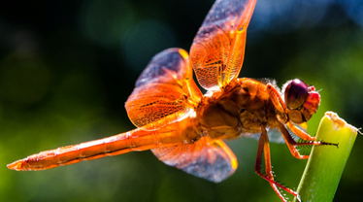
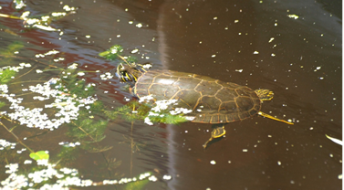
Water
Notes:
Kristina
-

Slide 27
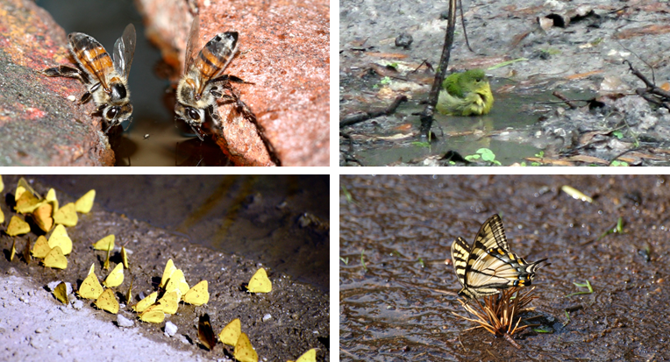
Water: Puddling Areas
Notes:
Kristina
-Butterflies engage in a behavior called “puddling” where they find a wet, muddy patch of soil, they gather and suck up the muddy liquid for the minerals
-Create your own puddling area by filling shallow dish with mix of sand, compost, and water, and place in sunny area.
-Bird, wasp, and bee species use mud to build nests

Slide 28
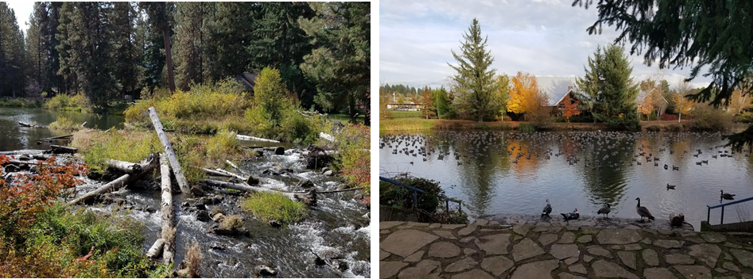
Water: Beyond our Property
Notes:
Kristina-
Don’t forget about water sources just beyond your property.
These show nearby water sources adjacent to backyards (or other properties) that also count as water sources.
This is a creek near Camp Tamarack in Sisters, OR and Wade Creek Pond at the Estacada Library.

Slide 29
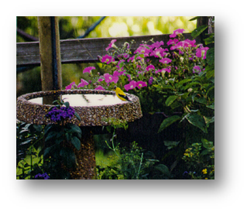
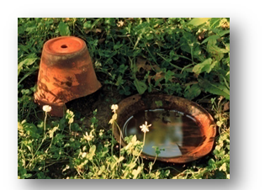
Water Sources
What water sources do I need?
Provide clean water for wildlife to drink and bathe:
Birdbath
Lake
Stream
Seasonal Pool
Water Garden/Pond
Ocean
River
Butterfly Puddling Area
Rain Garden
Spring
Notes:
Kristina
-Many different sources of water. Make sure that you have water at a variety of levels for different wildlife species.
-Make sure water is clean in bird baths
-Provide water even in cold winter months
-Large ponds attract herons, wading birds, waterfowl (ducks, geese), turtles, muskrats, beaver, nutria
-Smaller water garden for salamanders and dragonflies

Slide 30
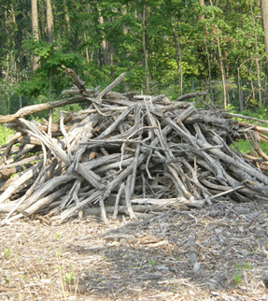
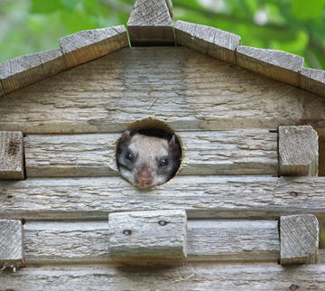
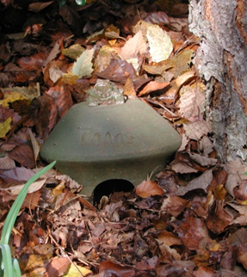
Cover/Shelter
Prey and predators need shelter. Dead trees, brush piles, and artificial shelters are all great options.
Notes:
Kristina -Wildlife needs places to find shelter from extreme hot and cold temperatures, high winds, storms, and other weather conditions
-Wild animals needs place to escape predators

Slide 31
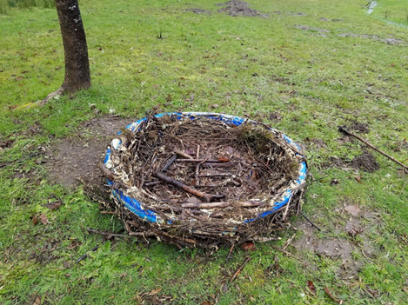
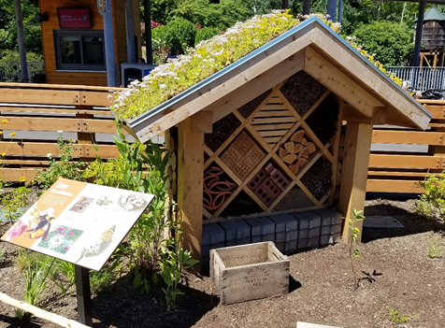
Cover/Shelter: Supplemental Projects
There are many creative ways to build cover and places to raise young to supplement natural sources.
Notes:
Kristina-
Large nest habitat (pile of branches) made from kiddy pool at Chintimini Wildife Center in Corvallis. Insect hotel at the Oregon Zoo Wildlife Garden (a Certified Wildlife Habitat).

Slide 32
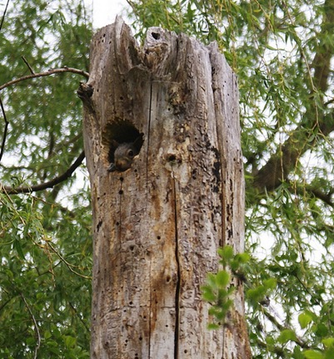
Cover/Shelter Sources
What cover/shelter sources should I provide?
Options for cover/shelter to consider:
Wooded Area
Standing dead trees
Rock Piles or Wall
Roosting Boxes
Dense Shrubs or Thicket
Nurse Logs
Evergreens
Brush or Log Pile
Burrow
Meadow or Prairie
Water Garden or Pond
Cave
Notes:
Kristina
-Leave sticks and logs/don’t burn
-Plants provide cover
-Restore grassland
-Roosting box vs. Nesting box (entry hole of roosting box is found at bottom of front side, which allows box to retain heat in cold weather. Inside, roosting boxes have perches and can be oriented vertically or horizontally)
-Bat house, butterfly house, insect hotels, amphibian houses (toad abode)

Slide 33
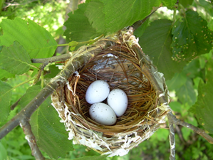
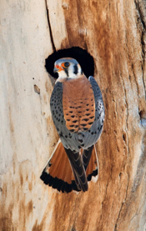
Places to Raise Young
Wildlife need space, thoughtful planning, and resources to ensure their safety.
Courtship, mating, nest building, egg laying, giving birth, and caring for young all require specific resources or careful planning.
Notes:
Kristina
-All wildlife need places to bear or raise young
-Provide space and resources to find a mate, engage in courtship behavior, places and materials to build nests or dig dens and burrows

Slide 34
Places to Raise Young: Nesting Boxes
Cavity nesters use holes in trees as nesting spots, but many will also use a well-placed nesting box too. Many bird species have certain birdhouse shapes that they prefer for predator evasion or nesting needs.
Notes:
Kristina
-Nesting boxes or birdhouses, but birds don’t live in them
-Mimic natural cavities in trees
-Each species has own nesting requirements

Slide 35
Places to Raise Young: Juvenile vs. Adult Needs
Some species have special habitat requirements for their young that are totally different than their adult phase.
Notes:
Kristina
-Different species have different habitat requirements
-Provide a variety of habitats
-Caterpillars of butterflies and moths only feed on certain “host plants”
-Monarch butterfly caterpillars can only feed on milkweed. Without the proper host plants, butterflies and moths can’t complete their reproductive cycle and populations decline
-Over 90% of native insects cannot complete their life cycles without native plants, which in turn takes away important food source for parent birds used with their young

Slide 36
Places to Raise Young: Sources
What sources of safety or places to raise young should I provide?
Mature Trees
Meadow or Prairie
Nesting Box
Wetland
Host Plants for Caterpillars
Dead Trees or Snags
Dense Shrubs or a Thicket
Water Garden or Pond
Burrow
Cave
Notes:
Kristina
-Lots of options for places to raise young, but make sure you know what species you want to target and provide them the correct habitat
-Variety is great
This birdhouse is at Morgan’s house which tree swallows are using for their nest.
*Always try to speak to natural shelters as well.

Slide 37
All Seasons
Leave the leaves and stalks!
Notes:
Kristina
Remember to think about providing habitat during all the seasons (having blooming species all year long). Your vegetable/fruit/herbs garden provides habitat too! This is Morgan’s garden in the spring, late summer/early fall, and winter. This is an example of leaving the leaves/stalks at the end of season (when plants are going dormant) for beneficial insects to make their home in so they can get through the winter and feed those spring babies.
-Examples of seasonal plants: Snowberry in spring and winter, Milkweed in summer and fall

Slide 38
Gardening for Salmon
Fertilizers and pesticides can harm salmon
Riparian areas (land along streams):
Keep water shady and cool
Absorb toxins before they reach the water and prevent soil erosion
Provide food and habitat for insects that salmon eat
Add complexity and habitat to salmon streams (e.g. fallen logs, deeper areas, riffles)
Notes:
Kristina
The Northwest Steelheaders recognize that in order to ensure thriving populations of fish for future generations, we need to protect the habitat conditions upon which these species depend. In spending our free time along rivers and lakes, anglers are able to clearly witness the adverse effects of pollution, runoff, and high water temperatures. Strong salmon and steelhead runs rely on cold and clean water flowing through healthy riparian areas. By creating wildlife gardens and cultivating native plants in our communities, we are helping to prevent soil erosion, reduce runoff, and ultimately provide healthy salmon habitat conditions downstream. Sustainable gardens = healthy water = happy fish!
According to Portland Parks & Recreation and the Bureau of Environmental Services: “Salmon are found in 125 of Portland’s 300 miles of streams and rivers and Parks oversees 11,000 acres of parks and natural areas, including one of the largest urban wilderness areas in the country.”
3rd most wildlife friendly city in 2019 according to NWF - Sustainability plans like the Climate Action Plan, the 2035 Comprehensive Plan - which aim to increase backyard gardens, biodiversity, and green infrastructure within the city.
Portland Area Watershed Monitoring and Assessment Program (PAWMAP) - plays a big role by measuring changes in habitat, water quality, and biological communities
The Intertwine Alliance - a coalition of 150+ partners working to preserve and nurture a healthy and regional system of parks, trails, and natural areas

Slide 39
Break
Notes:
End Kristina: Or shorten it to 5 min and place it directly in the middle point of this class.
(GOod place to insert a POLL)

Slide 40
Native Plants
90% of insects are specialists and rely on native plants for survival
96% of terrestrial birds rear young on insects (esp. caterpillars)
100% of adult amphibians (and most reptiles) are meat eaters – mostly arthropods, also small mammals and fish
Native to where?
What about cultivars?
Ornamental plants provide aesthetic value only
Notes:
Anya 35-36

Slide 41
Noxious Weed Species
Native plants evolved over 4.6 billion years in relationship to each other and the fauna they support
Ecological disrupters: have advantages that help them overwhelm native species, decreasing biodiversity
Can be harmful, or not very beneficial to wildlife
Alter the native ecology and use up resources otherwise occupied by natives
Take the place of species that feed “specialist” insects, interrupting the food web
Notes:
Anya

Slide 42
Habitats and how to achieve them at home
Find Your Inspiration!
Notes:
Suzi Slide 40- 46
Now that we understand the issues at hand, and habitat requirements, let's talk about making your yard fabulous AND ecologically healthy.
Think of one of your favorite places in Western Oregon.
Who can name a few for me? Put your answers in the text box.
This is where we start to think about how we can shrink our favorite places into healthy yards and acreage at home!

Slide 43
Meadow
Notes:
Suzi
Here’s an example.
Here’s an 85 acre conserved property from Columbia Land Trust right outside of the Dalles, Oregon. It’s the 4 Sisters Property. On it, is a vernal pool. We have spots like this right in the Willamette valley as well as the Clackamas Basin.
Does anyone know what those flowers are?
(It includes Camas and naïve bunch grasses).

Slide 44
Notes:
Suzi
Tim Miller who lives on a major thoroughfare road in Portland. He loves to go out into natural areas and takes that inspiration into his garden. The far right is a vernal pool with those same plant communities that Tim built.
I “heart” Tim Miller.

Slide 45
Notes:
Suzi
Tim recreated that Camas Meadow in his own yard…...beautiful wetland and all!
Right down to the large wood ‘snag’ in the middle.
Tims plants include Monkeyflower, Common Camas, Native Asters and Sword Fern

Slide 46
Notes:
Suzi -
This is the front yard of my dear friend Gaylen. She has a sunny yard and a love of flowerers to bring in the pollinators and Monarchs. She gets all of that with her low maintenance meadow! Oh, and a LOT of kudos from the neighbors!
She has even receive that awful ‘hell strip’ and made it another beautiful pollinator space. By the way, that is the barron awful piece of lawn or weeds or nothingness that lies between some streets and sidewalks.
Some of her plants are Ceanothus, Oregon Iris, Camas, Native bunchgrasses. Red flowering currant.

Slide 47
Forest
Notes:
Suzi
This Marie Pierre- Transplant from Northern France ...Standing in front of her new Home- and a wall of invasive Ivy in NW Portland right up against Forest Park. .
She worked VERY hard to get the invasives removed and find the forest understory that she knew could be there again. SHe even found this amazing stump from a tree logged more than 100 years ago!
Here also want to mention that when we talk anout naturescaping, we are not saying “rips out all non native things’ we are really talking about ADDING native things. We all have our pet pants that we love, Maybe they are Roses, or Lilacs or in marie pierres place-Tulips. Tulips remind her of her home in France and they are wonderfully integrated into her garden. Or maybe her garden is wonderfully intergrated into her tulips!

Slide 48
If you build it they will come!
Notes:
Suzi-
And as you can see, once the monoculture of ivy was removed, Wildlife came...and HOW!
Marie Claires yard not only now attracts pollinators, abundant songbirds, woodpeckers, hawks and even these big guys. We may also find that some of our wildlife really enjoys our native plants and the key habitat it creates as well. This is where the sharing magic happens. The deer or native brush rabbits may enjoy dining on some of your buffet. I just plant a little more and enjoy sharing. If sharing is not your thing, there are many native plants that are also deer and browser resistant.
Either way, you find your inspiration, find which plants work well within your yards constraints and you and just go with it!

Slide 49
Raingardens
Notes:
Anya 47 - 49
(1:10)

Slide 50
What is a raingarden?
Suzi Slide 40- 46
Notes:
Anya

Slide 51
Raingardens are diverse and should fit the place
Notes:
Anya
Oregon Rain garden Guide.

Slide 52
Hedgerows
This ain’t it!
Notes:
Suzi -
One word- NOPE. Not this.
Sometimes we just really need to screen something. The neighbor, the street, the ugly chain link fence……
Did you know that we (especially in rural areas) grow this fast moving laurel everywhere? Did you know that EVERY SINGLE PART of this plant is toxic (stems, leaves, berries). It contains hydro-cyanic toxins that can kill animals and humans if any part is ingested. Yet we stick these monsters EVERYWHERE.
What if we flipped the idea of privacy on its ear and planted this (next slide)

Slide 53
Notes:
Suzi-
Now, THIS is a beautiful, functional, excess water drinking, ugly view blocking, native hedgerow.
What makes this so special?
First- It is beautiful and has been planted with shrubs and forbes that will procude flowers throughout the growing season- so voila! Color all the time which means different pollinators all of the time (from hummingbirds to bees to butterflies, moths)
Second- it is REALLY important for our nesting songbirds- 60% of regional species nest in the SHRUB layer so native hedgerows are excellent habitat for many birds during the nesting season (Warblers, Sparrows, Towhees, and goldfinches) AND provide ample food for other birds and pollinators. Oh, and we can even plant native hedgerows that provide nibbling for US as well! (salal, crabapple, salmonberry, pearly everlasting, oregon grape)
Third- These things can grow fast and require not extra watering or pesticide use. Hedgerows make fast growing and EXCELLENT sight barriers! They have varied root depths with small, medium and large shrubs are EXCELLENT for absorbing lots of runoff. Win Win annnnd WIN!

Slide 54
Why should we care about Oregon white oak habitat?
Oregon white oak and prairie are habitats of concern at the local, Willamette Valley, state and federal levels
< 5% of oak habitats remain
Most of the remaining oak habitats are on private lands
Notes:
Nicole

Slide 55
Reference: John Christy and Ed Alverson, 2011
Historical Context: Habitat Loss
Habitat Type | Remaining
Upland Prairie | 1.3%
Oak Savanna | 1.8%
Oak Woodland & Forest | 14.4%
Terry Spivey, USDA Forest Service, Bugwood.org
Notes:
Nicole

Slide 56
A Continuum of Habitats
Habitat | Canopy Cover | Fire Frequency | Succession With Fire Exclusion
Prairie* | <5% | Higher
Savanna | 5-25%
Oak woodland | 25-60%
Mixed oak forest | >60% | Lower
* Includes other herbaceous communities, depending on soils & hydrology: upland prairie, wet prairie, balds, vernal pools
Notes:
Nicole

Slide 57
Roberta Schwarz
Notes:
Nicole

Slide 58
Why do we care about oak habitat?
Decline of oak and prairie habitats leads to the decline of the species that depend on them!
Mammals
western gray squirrel, black-tailed deer, black bear
Birds
acorn woodpecker, white-breasted nuthatch, western bluebird
Amphibians
long-toed salamander, red-legged frog
Reptiles
rubber boa, western skink, western fence lizard
Invertebrates
Fender’s blue butterfly, Taylor’s checkerspot, California sister
Plants
White rock larkspur, Kincaid’s lupine, thin-leaved peavine
Notes:
Nicole

Slide 59
Biodiversity
Biodiversity
Photos: Institute for Applied Ecology, TNC, Rod Gilbert
Notes:
Nicole-
High numbers of endemic species (unique to a place or habitat), complex plant-animal relationships, imperiled species.
Use the example of the Fender’s Blue butterfly with it’s larval host plant Kincaid’s lupine (at left). Both are at-risk and dependent on prairie.
Other species on this slide: California sister (butterfly at top center, feeds on exclusively on oak leaves), western meadowlark (yellow breast, at center), western gray squirrel, slender-billed white-breasted nuthatch (at right)

Slide 60
Cultural
Context
Photo Credits: Judy Bluehorse Skelton
Notes:
Living legacy social ecosystems; first foods: camas, other bulbs, wapato, deer; fire and land stewardship practices

Slide 61
Ted Labbe
Notes:
Nicole

Slide 62
How can you support Oregon white oak?
Conserve mature oak trees
Release oaks from faster-growing trees
Control invasive species
Oak naturescaping
Meadowscaping
Share with others about oak!
Notes:
Nicole

Slide 63
https://goo.gl/1MGzTR
https://goo.gl/q6bsVh
Notes:
Nicole

Slide 64
Questions on what we have covered?
Notes:
This is where we will have Lisa present any questions that may have come in to the chat box during the course of the class.

Slide 65
Creating a Wildlife Habitat Involves...
Investigating, Designing,
and Creating:
Conducting a site inventory and creating a map
Identifying design considerations for attracting wildlife
Identifying design enhancements
Project planning and implementation
Maintenance
Notes:
Morgan - While creating a wildlife-friendly habitat requires various steps including designing your habitat, project planning, implementation and maintenance, for the purposes of the following homework activity that I’ll be going over shortly, we’re going to focus on step #1 which is site inventory and mapping. But first ….

Slide 66
Build your DREAM habitat!
Notes:
(1:45) Morgan - … lets talk about Dream Habitats. A part of the goal of the following activity involving conducting an inventory of current site conditions is to start brainstorming your dream habitat, in other words your wish list. Think about if money, time, and expertise were no object - what would you want in your ideal habitat? What wildlife are you trying to attract? Think BIG (as later you can narrow down what may be more reasonable or practical for you at this time) and also remember that creating habitat is a really a lifelong project and time commitment so dare to dream.

Slide 67
Homework Activity: Site Inventory/Mapping & Dream Habitat
Notes:
Morgan - So now we’re going to add the activity worksheets in the chat window (if you can please open that and take a look) - https://drive.google.com/file/d/1la8gN0ZgUsKpXH2ZZvuWRXqXqJTW-0HP/view?usp=sharing. You’re all going to work on this between now and March 24th. You’ll see on the first page that you are asked to draw a map of your habitat area (whether that’s you entire property or just a section) and there are color coding suggestions for site characteristics. Page 4 is a blank document you are welcome to use for your drawing but if you prefer designing your map with digital resources, feel free to do that. This is your map so be creative however you wish. Page 3 is the National Wildlife Federation’s Certified Wildlife Habitat checklist. You can use this to identify whether the required habitat elements are already present and which areas you may need improvement still. This will also give you ideas of future projects for your dream habitat. Following the drawing activity is a worksheet called “Who Can Live Here?” which helps you spend some time focusing on one wildlife species that you would like to attract and researching what their needs are including the native species it depends on. We have a list of resources that may help you on the NW Steelheaders Garden for Wildlife page (which we will put in the chat): https://nwsteelheaders.org/garden-for-wildlife/. Next, there’s a Four-Season Habitat Planning chart that can be useful for thinking about your to-do list throughout the year in order to develop or enhance your wildlife habitat projects.
When we come back together again for the next session on March 24th, we’ll be sharing what you created and discovered about your habitat so please take a picture or scan your map to share with others.
Are there any questions about the activity?

Slide 68
Other questions?
Please take our anonymous survey for a chance to win a raffle prize!
Notes:
Survey link: https://forms.gle/dsjoDDx172BPPNXa9

