Slide 1
Gardening for Wildlife: Naturescaping Fundamentals
Part 2: Creating Habitat at Home
March 17 and March 24, 2021
Suzi Cloutier ~ Anya Pickard ~ Morgan Parks ~ Lisa Kilders ~ Kristina Peterson ~ Nicole Ahr
Notes:
Introduce presenters and organizations

Slide 2
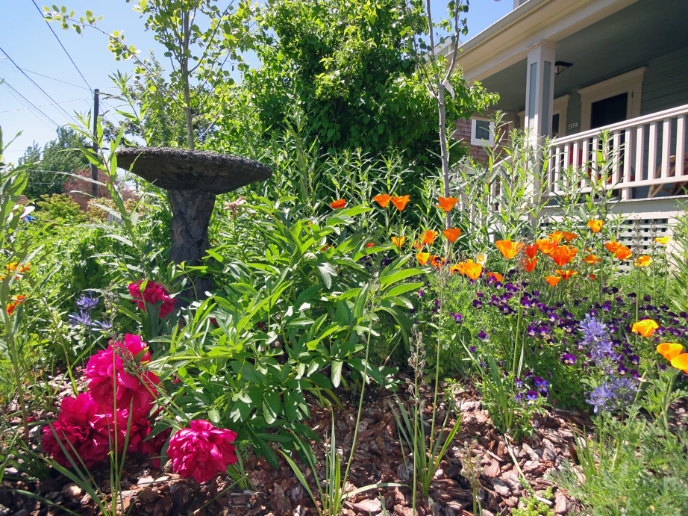
Welcome back!
While we wait for attendees to join, please write in the chat:
Where you’re joining from
Are you growing anything fun?
What do you hope to learn tonight?
Notes:
Where are you all from?
What is your watershed?
Favorite thing about your yard? Least Favorite thing about your yard?

Slide 3
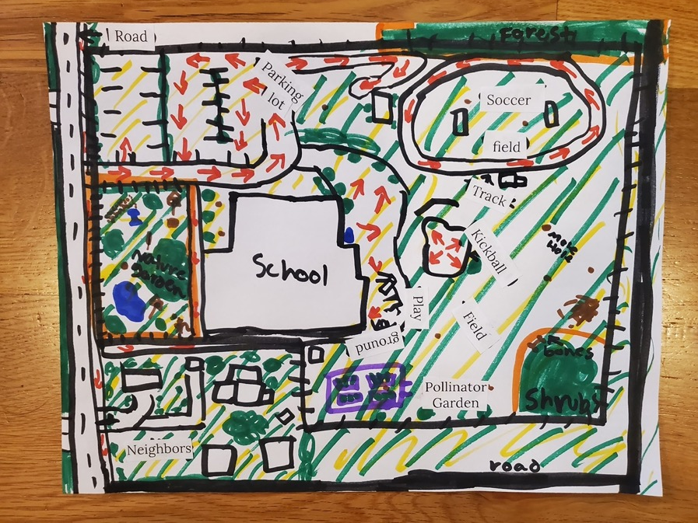
Review Site Inventory/Mapping & Dream Habitat
Notes:
Morgan - At our last session, you were all tasked with creating a site inventory and map of your habitat area. Hopefully you came up with some creative representations and project ideas. If you did not get a chance to complete this activity, here is a link for reference in the chat: https://drive.google.com/file/d/1la8gN0ZgUsKpXH2ZZvuWRXqXqJTW-0HP/view?usp=sharing. We are now going to split everyone into breakout rooms of 6-8 people for 20 minutes.
While we’re breaking everyone up into groups, here’s what you’ll be discussing as a group.

Slide 4
Breakout Rooms - 20 Minutes
*Please choose one person to share a key takeaway from the activity or ask a question on behalf of your group.
Remember your Group Number!
Share:
Name
Where you’re located
Give an overview of the map that you created (can hold up image or share screen) and what you discovered
Did anything surprise you? (i.e. an area of improvement you didn’t realize)
Notes:
Morgan - In your groups, please turn on your videos if you’re comfortable and then take turns saying your name, where you’re located, and share your map (you can hold up your image or share your screen to show your photo, etc.), and also share if there was anything that surprised you during this process? If you didn’t do the activity, no problem, feel free to share whatever you’d like about your yard or just listen and observe. You’ll need one person to report out if there was a key takeaway from the activity or a question that the group had and would like to ask. I’ll briefly go over how to share your screen incase that’s new for some folks. At the bottom of your screen is a green box with an up arrow on it that says “Share Screen” - you can click on that and then search for what file you have open on your desktop or screen. Please remember your breakout group number. Also know that we may pop in and out of your room just to make sure things are going smoothly. Are there any immediate questions about any of this?

Slide 5
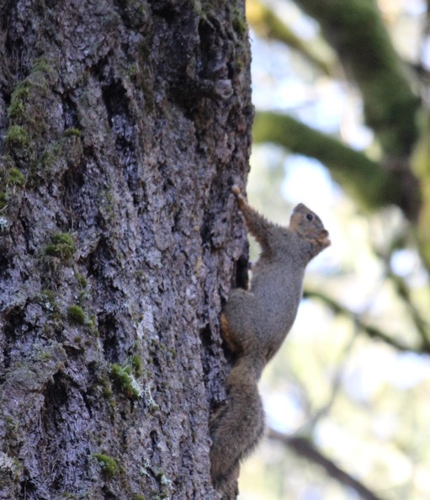
Share Out
Select one member of your group to share a key takeaway or question on behalf of the group
Notes:
Morgan - We’re going to spend 10 minutes or so having a representative from each group share out.
Alright, let’s just go in order of the breakout rooms, can we have the reporter from group 1 please share a takeaway or question? Thank you! And now group 2, etc.
Thank you to everyone for participating! Hopefully, this exercise helped get the ideas flowing and got you excited about possible projects that you could get started on this spring and summer. And now we’re going to take a quick poll and afterwards will learn about why pesticide reduction can be of benefit to those habitat projects you just talked about.

Slide 6
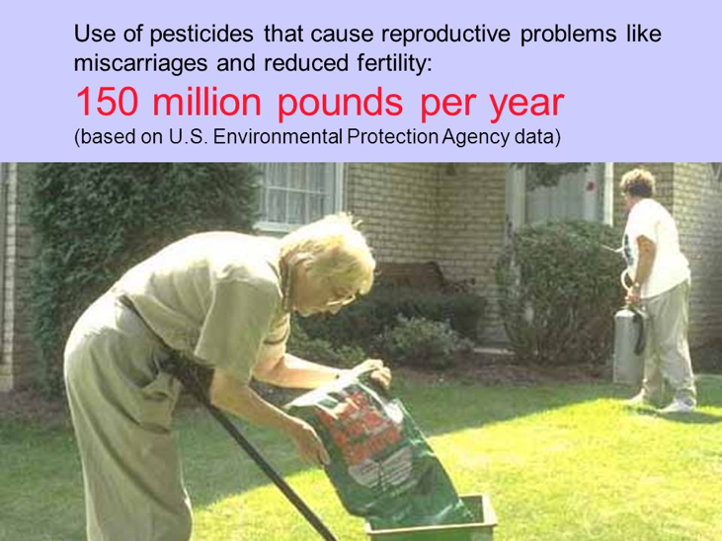
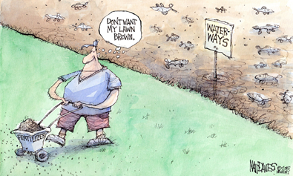
Pesticide Reduction
Notes:
Suzi
Pesticides, human health and the environment
Pesticides include some of the most hazardous chemicals commonly used in and around the home. Products that kill insects, weeds, bacteria and fungi may be hazardous to children, pets, birds, fish, other wildlife, and also to beneficial insects like bees and ladybugs.
Pesticides used in the yard or at the workplace can be carried inside on shoes and work clothes and mix with house dust. Young children, who crawl on the ground and put objects in their mouths, can then ingest the chemicals.
Aquatic wildlife including FISH- Rain and irrigation wash pesticides off of yards and carry them to streams, oftentimes in amounts that can harm salmon or the aquatic organisms that are their food. This stuff also kills amphibians and other aquatic animals.
Kiddos-In 2009, United States poison centers had over 90,000 incidents related to acute exposures to pesticides - about 45% involved children under the age of six.
Pets- Many pesticide products are toxic to dogs, cats and other pets. The risks can be similar to the human health risks. Pets with access to treated landscapes may pick up pesticide residues on their paws and fur, licking it or tracking it into the house. Pets can Die from slug bait.
Bees and other pollinators- Most insecticides are toxic to beneficial insects, bees and other pollinators, and some insecticides are toxic to birds. Insecticides can kill bees directly when they eat or even just land on treated plants.
Chemical Persistence- The longer a pesticide remains in the environment, the more likely it is to do damage. Older products, like DDT, are still in the environment and in our bodies almost 40 years after their last uses were banned.
Since 2000, water quality monitoring in the Clackamas Basin has been undertaken by the DEQ has detected pesticides that exceed acceptable benchmarks that are healthy for fish and invertebrates in Clackamas River tributaries.A great number of the pesticides found in the lower tributaries are found in common yard care products as well as commercially used pesticides.
In addition to stream health, many garden chemicals also kill our most important beneficial insects including our already dwindling pollinators.
When homeowners like you make the decision to stop using pesticides, you help to ensure the long term improvement of our watershed.

Slide 7
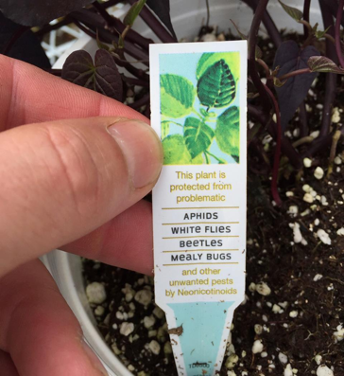
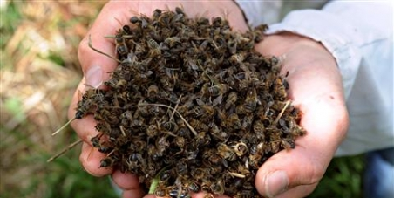
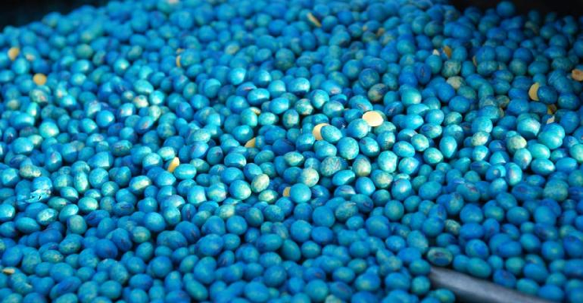
Notes:
Anya: · What they are:
· Derived from nicotine, neonicotinoids act on certain kinds of receptors in the nerve synapses. They are much more toxic to invertebrates, like insects, than they are to mammals, birds and other higher organisms.
· Generally, seeds are coated in the pesticide before they’re planted in pots, and, as a plant develops, the chemicals move into the leaves, roots, pollen, nectar, and even the food products eventually made from the crop. So, it’s a systemic additive.
· If insects feed on any part of the plant — even water droplets released by plant leaves — the pesticide, a neurotoxin, kills them. In the case of honeybees, if the amount of pesticide ingested isn’t strong enough to kill them, it can still cause impaired communication, disorientation, decreased life span, suppressed immunity and disruption of brood cycles.
· Possible lead to Colony Collapse in honey bees
o Outlawed in EU, but not here
o Ex: Wilsonville Target 2013 –sprayed linden trees for aphids 25-50,000 bees, 150 colonies
· Know your sources –buy from reputable nursery, not just anywhere

Slide 8
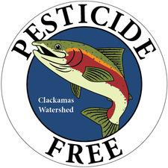
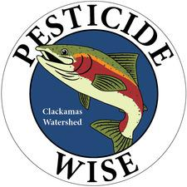
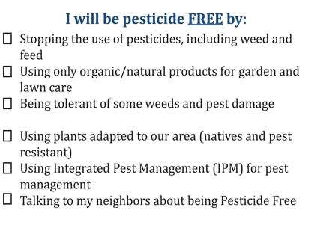
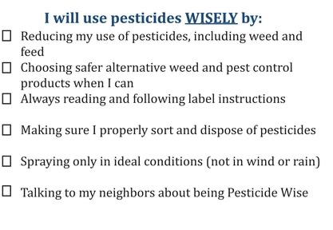
Notes:
All is not lost people!
Adam slide 8-9
You have power to reduce your pesticide (and herbicide and fungicide) consumption and its EASY!
Remember, if you choose to plant natives, you are chosing to plant stuff that needs no additional watering AND is pest resistant so should requirte NO pesticides. Wow!
FIRST- you are attending this class and thinking about planting with natives (which- might I remind you, are naturally Pest resistant)
SECOND- can vote with your wallet- remember the above neonics. Purchase only Neonic FREE plants from the nursery.
THIRD- Follow some basic guidelines and you will be part of the Solution and not part of the problem!
You can also get some cool swag to show off to your neighbors to boot if you live in the Clackamas Watershed. Just go to the CRBC website to sign up for the Parting with Pesticides Pledge.

Slide 9
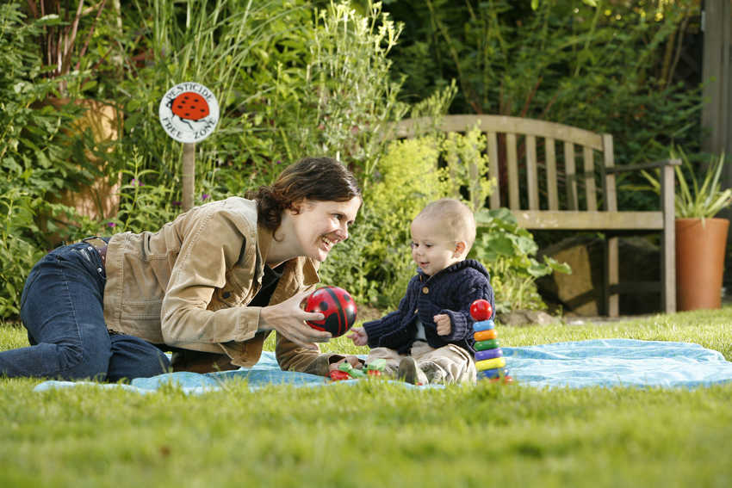
Metro Healthy Lawn and Garden Pledge
Notes:
Adam
I love this photo, it reminds me of all of the reason WHY we want to keep our gardens healthy…to keep us healthy
Kids, pets, coming into your home.
While the Metro healthy lawn and gardens program is suspended until this little covid thing is over,(next slide)

Slide 10
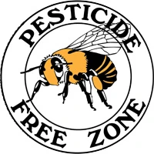
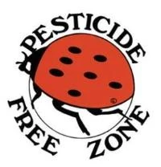
Beyondpesticides.org
Notes:
You can go to Beyond Pesticides.Org to purchase any of these three really cool ways to show off your amazing pesticide free yard.

Slide 11
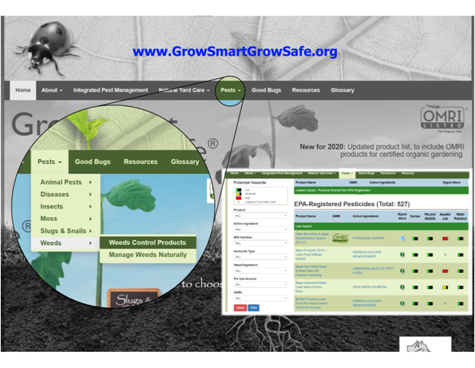
Grow Smart Grow Safe-
Your handy users guide to smart gardening!
Grow Smart Grow Safe
https://www.growsmartgrowsafe.org/
Notes:
Anya

Slide 12
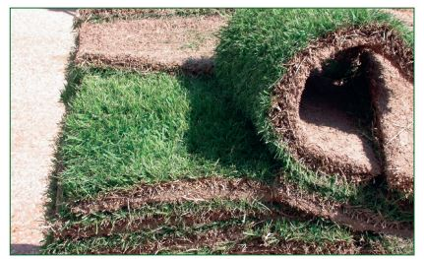
The importance of deep roots aka: why lawns suck
Notes:
Anya: Stormwater management is a big deal in the Pacific NW because we have very wet winters –obvious to all of us, but that’s really different from many other places where winters are cold, but dry. Our native plants are adapted to these particular conditions.
Some stormwater management actions:
· Disconnecting downspouts from stormwater drains
· Raingardens
· Water conservation
· Restoring soils by leaving leaves and woody debris
· Native plants and especially large canopy trees
· Removing impervious surfaces –lawn grass can be considered an impervious surface!

Slide 13
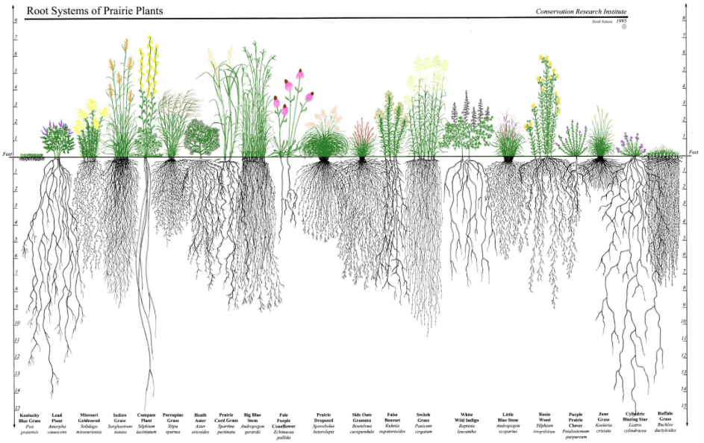
Stormwater
Erosion control
Water quality
Watershed health
How to improve:
Native plants enhance soil
Large canopy trees
Rain gardens
Leave the leaves
Notes:
Anya: Sod root depth is on the far left. Native bunchgrasses to the right. Native plants –especially large canopy trees:
· Erosion control
· Carbon sequestration
· Help with water percolation, infiltration
· Divers and Robust root systems have micro organisms that also process water and move nutrients
· Affect Water turbidity –clean the water in streams/streamside situations
· · Improve watershed health
o No surprise that plants that evolved here have an incredible ability to hold themselves in the ground
o Larger biomass of natives increases percolation, and enhances the soil complexity, which further increases the ability to hold water further
o Enhance by Planting large canopy trees
§ 1 large tree takes up 100g/day and processes, discharges in ONE day
§ 1 mature Doug Fir can take up 800g/day

Slide 14
BREAK
Please take 10 minutes to use the restroom, grab some food, etc.
Notes:
For realz…..make it a silent break.

Slide 15
Questions?
Notes:
NICOLE will compile questions from first half and ask them here.

Slide 16
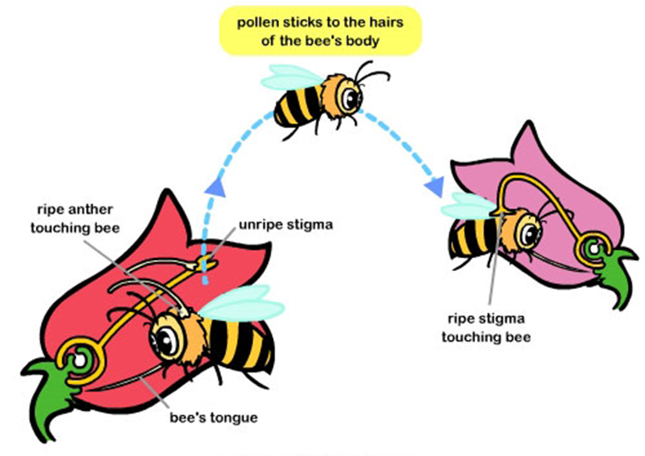
Pollination
“At least one-third of the world's agricultural crops depends upon pollination provided by insects and other animals.”
Credit: http://www.sciencewithme.com/learn-about-pollination/
Notes:
Morgan - Now we’re going to talk about Pollination. Pollinators are animals that move from flower-to-flower while searching for protein-rich pollen or high-energy nectar to eat. Pollinators are essential to the food supply for people as well as for wildlife. As they visit flowers in search of food, they are dusted by pollen and move it to the next flower, fertilizing the plant and allowing it to reproduce and form seeds, berries, fruits and other plant foods that form the foundation of the food chain for other wildlife species—including humans. Pollination can occur by air, water, and organisms with agents like wind, rivers, insects and birds. There are several types of pollination: self pollination (occurs on the same flower or flowers of the same plant), cross pollination (between flowers on different plants), and artificial (by hand, manmade). Pollinators are critical for pollinating ⅓ of our agricultural crops (the food we eat) which amounts to between $235-577 billion US dollars which just goes to show how important they are for continued life on earth.

Slide 17
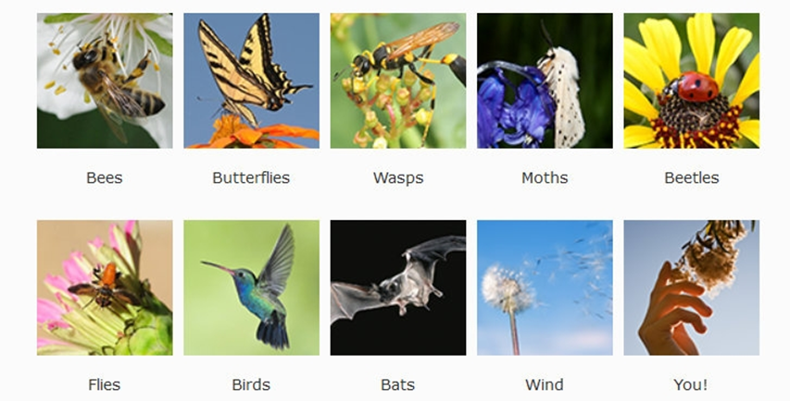
Types of Pollinators
Credit: https://ucanr.edu/blogs/blogcore/postdetail.cfm?postnum=18074
Notes:
Morgan - There are many different types of pollinators. In North America, bees, butterflies, moths and some species of beetles, wasps and flies are pollinators, along with hummingbirds and two species of bat. Even people affect pollination through our behaviors such as transporting seeds. An easy way to remember all the pollinators is to just remember the B’s – bees, butterflies, birds, bats, bugs, and behaviors!
In the chat window, we’ll put some additional tips for attracting pollinators: https://drive.google.com/file/d/1w65r7IEl5jj5VTSUwNwBP2rKdJilkJXZ/view?usp=sharing

Slide 18
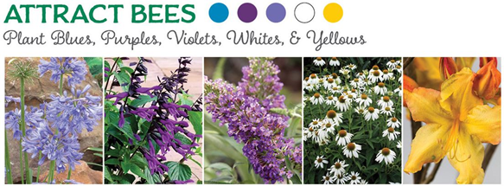
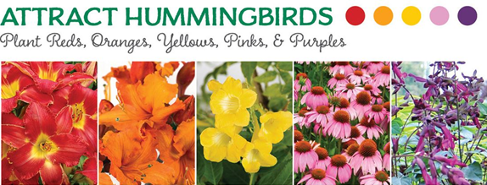
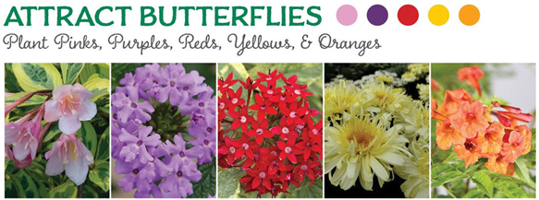
Credit: https://www.southernliving.com/home-garden/gardens/flowers-attract-hummingbirds-butterflies-bees
Notes:
Morgan - One of the ways to attract specific pollinators is through flower petal colors. For instance, bees are attracted to violet-blue colors while hummingbirds like red and oranges. We also know that pollinators prefer dense clusters and clumps of the same plant so be sure to plant in groups so they can see large landing zones of color. When you plant every other (like yellow red yellow red), even though it might look pretty and uniform, it’s not natural so always try to think of how mother nature would look - which is often messy and chaotic but teeming with life! So just remember that flowers clustered into clumps of one species (and the same color) will attract more pollinators than individual plants scattered through a habitat patch.

Slide 19
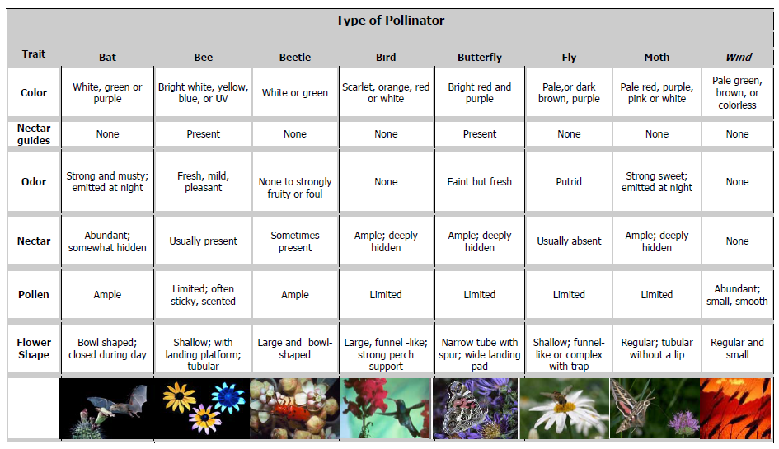
Pollinator Syndromes
Credit: North American Pollinator Protection Campaign
Notes:
Morgan - Pollinator Syndromes: https://drive.google.com/file/d/1ATIABd4tHuFcExykgCfzeslg_dXQKtc_/view?usp=sharing
Other characteristics that attract different species are what’s called Pollinator Syndromes - these are flower characteristics, traits, or cues that appeal to various pollinators. It’s important to have variety if you want to attract diverse pollinators.
For example:
Bees don’t see the color red (it’s invisible to them as they see ultraviolet light), they also like landing platforms, and nectar guides (which are patterns like speckles, dots, or stripes on the throat of a flower)
Short-tongued bees like flowering herbs, long-tongued bees prefer tubular flowers
Beetles like odors and simple flowers with an open bowl, dull, white, or reddish color
Flies like small, shallow flowers, in drab colors – like brown, purple, and with a bad odor
Butterflies (are generalists), and like perching platforms, with a light scent, and composite flowers
Moths like strong and sweet smells, flowers that open in the late afternoon/evening, and clusters of white/pale flowers that they can see in dark.
In summary, if you’re not seeing the pollinators you want to see - think about pollinator preferences when selecting plants for your yard.

Slide 20
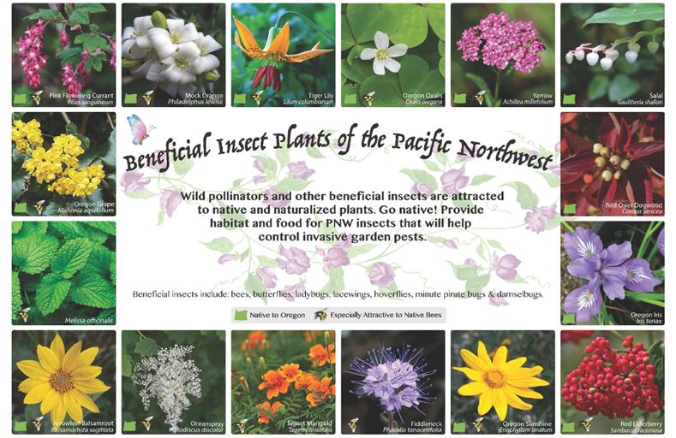
Native Plants in the Pacific Northwest
Oregon Flora
Notes:
Morgan - This is a resource I like (which we’ll put in the chat - Beneficial Insect Plants: https://drive.google.com/file/d/1ZY4_DgmEkrHw8BmveNndcwbhLl_ssAwt/view) as it’s a good reminder to plant blooming species that attract beneficial insects throughout the growing season. Overlapping flowering times provide continued forage. As you can see, pink (or red) flowering currant is getting ready to bloom right now, with others like Oregon Grape, Oregon Iris, and Red Osier Dogwood blooming later this spring. And something like Oregon Sunshine can benefit insects into the late summer.
A new website that you should definitely check out is Oregon Flora: https://oregonflora.org/garden/index.php which is essentially a database of native plants which you can filter by plant needs, plant features, growth and maintenance, ecoregion and habitat type. You can even search by what kind of pollinators you’re trying to attract - so be sure to check it out!

Slide 21
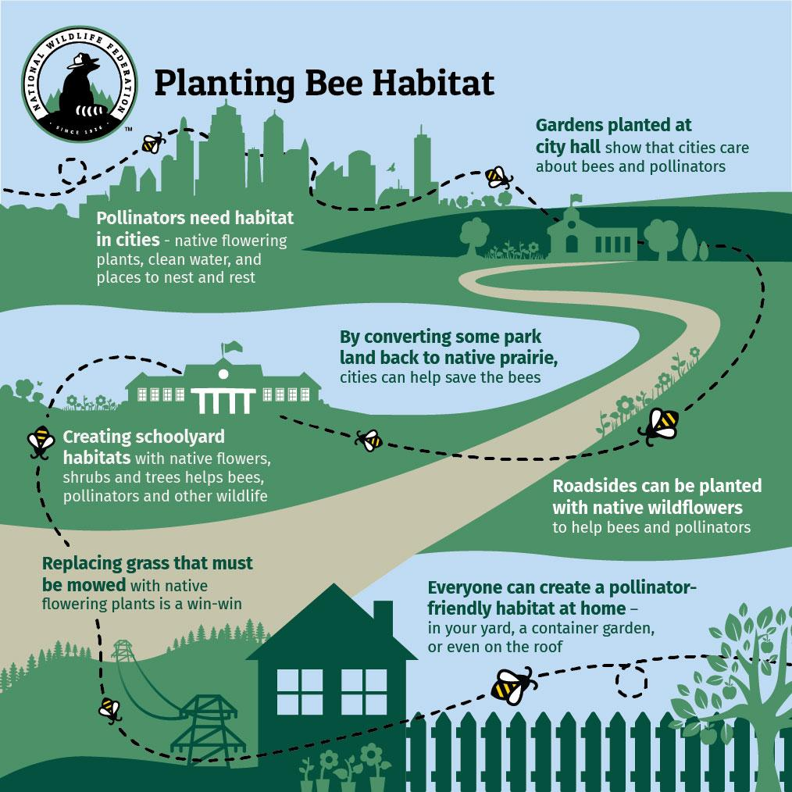
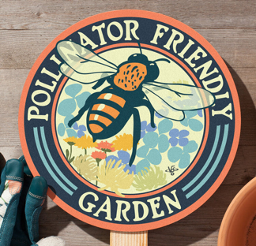
Victory Garden of Tomorrow Garden Signs
Beesponsible Toolkit
Notes:
Morgan - As bees are our most important and efficient pollinators and wild flowering plants rely on them for pollination and reproduction, it’s important to create bee-friendly gardens as we have over 4,000 native bees in North America! In the chat window, we’ll share the Beesponsible Outreach Toolkit for Municipalities: https://drive.google.com/file/d/1JhhgP6E8W8qbGdIw1A7AKgsGbqxYBZQQ/view?usp=sharing to help spread the word about the importance of bees, the challenges they face, and the actions your fellow community members can take to help. Pollinators are declining world-wide due to various factors including habitat loss, pesticides, disease, land use changes, and climate change. The once-common rusty patched bumble bee, which was recently listed as endangered in the U.S. and the beloved monarch butterfly, which has declined by 99% in the west are examples of species on the brink of extinction.
To show your commitment to bees, display a pollinator sign such as those from Victory Garden of Tomorrow (which Adam already mentioned): https://www.victorygardenoftomorrow.com/gardensigns-1 (this is a local Portland company that makes various attractive garden signs featuring pollinators and other wildlife). Another great option is Xerces Society’s Pollinator Habitat Sign: https://gifts.xerces.org/products/pollinator-habitat-sign-2020. One thing to remember as far as bee habitat is to be sure to keep areas of undisturbed soil and grassy patches in your yard as many bees build their nests either in the ground, rodent burrows, grass clumps, dead snags, or rotting logs.
And now we’re going to learn more about other beneficial insects from Lisa!

Slide 22
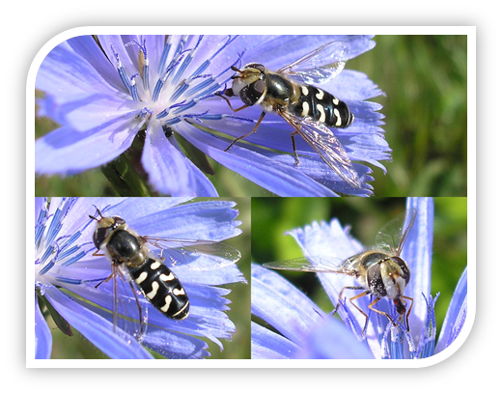
Recognize Your Friends
An introduction to beneficial insects
Notes:
Lisa

Slide 23
Special Thanks To
Gwendolyn Ellen
Farmscaping for Beneficials Project
Integrated Plant Protection Center
Oregon State University
Notes:
Lisa

Slide 24
Put Your Preconceived Notions on Hold
Is this you?
•Ew! Squish it!
•The only good spider is a dead spider!
•Ack! I have aphids! Better spray!
Notes:
Lisa

Slide 25
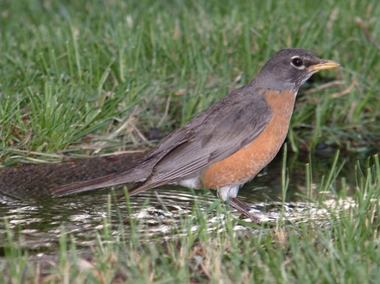
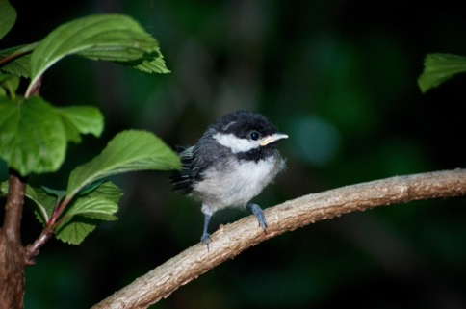
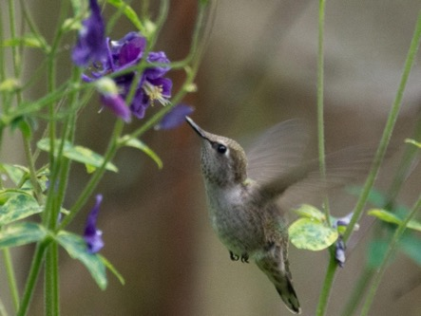
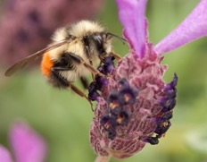
Why do we want beneficial insects?
Photos by Jason Faucera and Joseph Berger
Notes:
Lisa
Several reasons:
Obviously, these insects help control garden pests without the use of pesticides!
Habitat for beneficial insects are beautiful AND provide habitat for pollinators!
The increase in beneficial insect populations provide food for birds

Slide 26
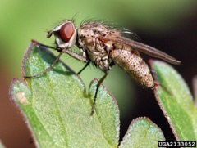
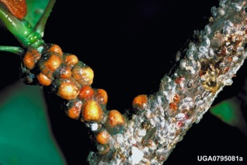
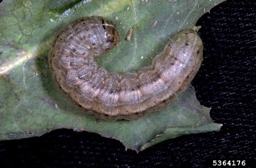
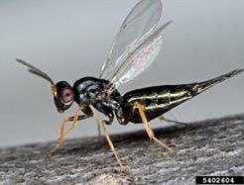
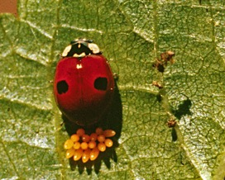
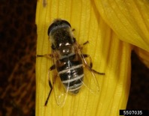
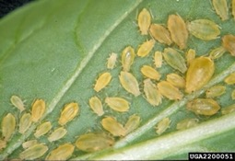
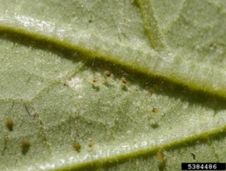
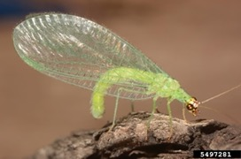
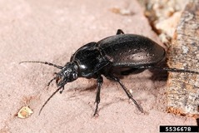
Who are the pests and
who are the natural enemies?
Bad guys
Good guys
Photos:
G. Lenhard
W. Cranshaw
N. Hummel
F. Peairs
J. Berger
P. Sloderbeck
D. Cappaert
Notes:
Lisa
Make sure you aren’t killing off the good guys when you battle the bad guys!
Bad:
Scale
Caterpillars
Aphids
Spider mites
Good guys:
Lady bug
Parasitic wasp
Tachinid fly
Hover fly
Ground beetle
Lacewing

Slide 27
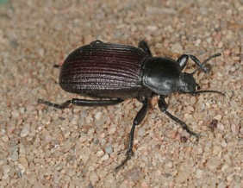
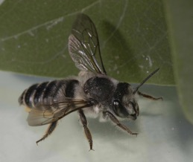
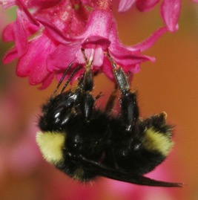
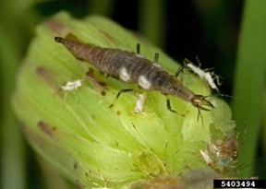
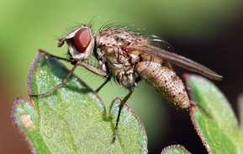
Three functional groups of beneficial insects
Predators
Parasitoids
Pollinators
Photos:
L. Ketchum
D. Cappaert
M. Vaughn
Notes:
Lisa-the big 3 P’s
Predators go through life gorging themselves on pests, and sometimes other beneficials, but their benefits go far beyond the occasional meal of a buddy.
Parasitoids lay their eggs on OR in a garden pest and it is that developing insect that is the one who does the damage. I have some cool video to show in a few minutes.
Then there are pollinators. While pollinators are very necessary for production of our food (nearly 75% of the worlds food crops), they are not natural enemies of our garden pests. The exception are hornets and yellow jackets who provide some minor pollination benefits, but will in fact prey on pests like grasshoppers and caterpillars.

Slide 28
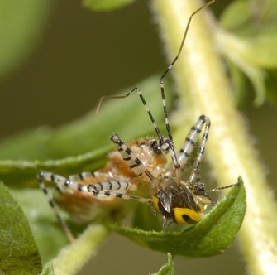
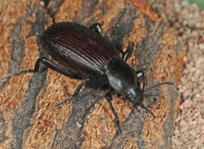
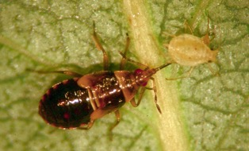
Predators need prey (garden pests) to survive, so let’s talk tolerance levels.
You need to keep your army alive if you expect them to attack an outbreak of pests!
Scouting and identification is the key to making a sound decision.
Notes:
Lisa
You must have a food source for your beneficials so don’t expect your garden to be pest free! Then when you do have a major outbreak you have your beneficial army ready.
However, you must also realize that control does not happen overnight. You must expect to have insect activity (good and bad) in your garden. You must also decide what your tolerance level will be. If you have a very large outbreak you need to scout and identify if your beneficial army has gone to work. If it has...be patient.
If you do not have any beneficial insects you may consider pruning the insects out of the plant or some low toxicity options like Safer soap or neem oil depending on your pest.
.

Slide 29
Some predators require pollen and nectar sources in addition to prey to survive and reproduce.
Photos:
W. Cranshaw
J. Berger
P. Sloderbeck
G. Hampshire
Notes:
Lisa
Here is where our garden habitat comes into play. For the beneficial insects whose larvae attack the garden pest, you must make sure the adults have food to reproduce. This means there must be flowers available from early spring to fall!
(many young are carnivorous while their adults are pollinators)- is this true Lisa?

Slide 30
Parasitoids
These parasitoids also need nectar and pollen to survive as adults and reproduce.
Their offspring feed on pests.
Thinking about common habitat needs?
Photos:
D. Cappaert
K. Chamberlain
J. Berger
Notes:
Lisa
Parasitoids lay their eggs on or in a garden pest and it is the larvae that kill the pest. Scouting is very important in this situation. If you see a pest such as a caterpillar with white eggs on it, do not kill it! Those larvae are killing the insect and then an adult parasitoid insect will emerge to fly off and kill another pest!
Do you see the common habitat needs for the predators and the parasitoids? Flowers blooming in all seasons!

Slide 31
Making Aphid Mummies
Videos provided by Dr. Steven Wratten
Photo by R Dufour
Notes:
Lisa
Here is another case where scouting is very important! If you see aphid mummies in your infestation of aphids, you know your beneficial insect army is hard at work. Aphid mummies are the bloated gray or white bodies of aphids.
Top left video: This is an adult parasitic wasp ovipositing an egg into an unsuspecting aphid. The “stinger of these parasitic wasps have evolved into “ovipositers” which allows the wasp to insert her egg into the aphid. The aphid then does not feel so great and puffs up into what we call a mummy. Some mummies are silver, tannish like the ones on the picture on the right, some are black and others whitish depending on the species of wasps that have parasitized them.
All these videos came from Dr. Steven Wratten, the king of beetle banks in New Zealand.
Next go to the video on the top right: Here a mature parasitic wasp has developed from her egg. She is chewing her exit hole in the aphid which is almost completely round.
Next go to the video on the bottom left and you will see the adult wasp exiting the dead aphid.

Slide 32
Providing Habitat
Success requires thinking like an insect.
Shelter from pesticide and soil disturbance
Sources of food (insects and flowers)
Provide a source of water
Places to reproduce and spend the winter
Notes:
Lisa
Where would you go to get away from pesticides or soil disturbances? Perennial beds are great because you don’t dig up the soil every year.
Clumping grasses like (cALIFORNIA ROMERS FESCUE, TUFTED HAIRGRASS, WILDRYE, foothill sedge in oak savannahs)
Fescue, Miscanthus, fountain grass or Pennisetum, and switch grass have a good base for insects to hide and they are high and dry, perfect for overwintering ground beetles. Sometimes we call these beetle BANKS. Make sure there is food - leave a small population of pests and have blooming flowers early spring through fall.
When we talk about a water source we aren’t talking pools. How many of you have seen dead insect who tried to drink in a pool? They usually drown. Bird baths, small divots in landscape rocks or saucers filled with rocks that are shaded and have water even for part of the day will work. If you have a bird bath, add a branch that is large enough for insects or even small birds to land on and work their way down to the water. Some birdbaths are beautiful but smooth and do not provide good footing. Even sprinkling foliage in the morning helps provide water.
Are you seeing that the basic needs for wildlife and beneficial insects are sounding the same?

Slide 33
Your Garden Can be Beneficial
AND Beautiful!
Plant for continuous bloom spring thru fall
Plan for a range of heights: groundcovers to tall flowers/ shrubs
Pay attention to flower shapes
Grow in blocks to reduce travel requirements
Notes:
Lisa
Who doesn’t want to see flowers all season?
Think of your garden as having layers. Shrink down to insect size. Are there ground covers, mid-level flowers, taller flowers and shrubs, and even flowering trees?
Look at the shape and types of flowers you have to offer these insects.
Plant in clumps! Not just onesies.
Because the beneficial insects that use pollen and nectar to survive tend to be small, they need small flowers that exist in clusters. Kind of like having a fast food restaurant on every corner. They won’t have to fly far to find the next nectar source. Go for flowers that are flatish and have easily accessible nectar and pollen. Tubular flowers are great for humming birds, but they offer beneficial insects nothing.

Slide 34
Let’s talk plants!
Three main flower types are most useful:
Carrot Family
Mustard Family
Aster Family
S. Rae
Samdani.srabon
Francy, DB
Notes:
Lisa

Slide 35
Go forth and make your garden beautiful and noisy with beneficial insects!
Notes:
Lisa

Slide 36
Let’s talk Habitat Zones and Plant Communities
Notes:
Anya: The Portland Plant List has a section on Plant Communities that has 9 different habitat zones that it examines
o These include areas like Doug fir-W. hemlock forest, Mixed decid-conif forest, Oak prairie, Wetlands, Floodplains, Rocky Outcroppings
§ These are based on conditions in mid-1800s and may require adaptive thinking about current urban conditions
· Reflected heat
· Pedestrian, canine traffic
· Street clearances
§ Forest –Steep dry slope = dry urban situation
§ Wetlands = Raingardens
§ Urban heat island effect: east side v west side temps
· Many people using more NoCAL plants or E. OR plants –remember our wet winters!

Slide 37
Conditions in your yard
Notes:
Anya: What are your conditions and how will you care for your plants?
· Reflected heat
· Sidewalk/street clearance, visibility, and abuse
· Moist areas because of activities

Slide 38
Plants for your yard
Choose resilient plants
Get them off to a great start
Be realistic about the care you will give
“Right plant, Right place!”
Notes:
Anya: Native substitutes for common ornamentals:
o Hydrangeas = Mock orange
o Butterfly bush = RF currant
o Boxwood = Evergreen huck
o Epimedeum and Coral bells = Inside out flower and Fringecups or Foam flower
o Pieris/Andromeda = snowberry
Choose resilient plants that are right for the location and how you will care for them
· Create more shade for less weeding/lower maintenance
· Plant the biggest tree that fits the space –consider height and width
· Start them off right with amendment, mycorrhizae, deep watering weekly for trees
· If you meadowscape, start with fresh ground, don’t add wildflowers to lawn to “go wild/native!”

Slide 39
Gardening with native
plants and other resources
https://www.portlandoregon.gov/bes/article/40355
Notes:
Anya: [Adam please click the link and scroll down to the Plant pictures] This free poster from BES shows some of the common native plants, by canopy layer and by preferred conditions. This is a great place to start!
Also, we would be remiss if we didn’t mention TEK for habitat restoration -indigenous knowledge is very important for healing the land and nurturing our connection the plant and animal worlds. See Robin Wall Kimmerer’s book Braiding Sweetgrass and maybe listen to one of her self-read essays to learn more and enrich your relationship as part of nature.

Slide 40
Backyard Habitat Certification Program
How it works:
Sign-up ($35)
Initial technician visit (1 hour)
Receive resources and coupons
Customized site report
Dig in! (5 criteria)
“Ready to certify!” visit
Certification sign, recognition and “benefits”
Upgrades (as needed) /renewals (3+ years)
Since 2009, over 7400 people have enrolled to enhance their yards. This represents over 1800 acres in 4 counties, and over 115,000 native plants planted!
Notes:
Anya

Slide 41
National Wildlife Federation
Two main goals for over 50 years:
Help wildlife!
Help people!
Notes:
Kristina
-There are many benefits to certifying your yard besides offering wildlife a place to thrive.
-This program has been around for 50 years

Slide 42
Certified Wildlife Habitats
5 Easy Requirements:
Food
Water
Cover
Places to Raise Young
Sustainable Gardening Practices
What can be certified? Anywhere in Oregon or US!
Yards
Balconies
K-12 Schools
Businesses
City Spaces
Farms
Places of Worship
Nature Centers
Museums
Community Gardens
Parks/Forests/Refuges
Roadsides
Universities
No acreage size requirements, no site visits, never expires, easy self-certification process
NWF and ANWS team up on Garden for Wildlife!
Notes:
Kristina
-NWF and ANWS- State affiliate that share GFW
-Different from other programs are no size requirements, no site visits.
-Inclusive, easy certification
-Intention is to provide simple process to get engaged in wildlife conservation
-Good first step
-Helps them want to learn more

Slide 43
Certify Online
$20 to register, $30 for sign ($10 off during month of May when you certify and buy a sign)
$5 from every certification in Oregon goes to support salmon thru the Northwest Steelheaders!
Get a free yard sign if you certify following this class.
Email us!
Over 3,896 Certified Wildlife Habitats across Oregon!
www.nwf.org/gardenforwildlife
Notes:
Kristina
-May is Garden for Wildlife month
-Only $40 during May to certify and get sign
-Luckily, by taking this class, if you would like to certify, email Orhabitat@nwf.org and we will mail you the sign for free. This means you’re only paying $20 for certifying
-741 NWF Portland, Oregon Certified Wildlife Habitats, 60 of which are Schoolyard Habitats

Slide 44
Questions?
Please take our anonymous survey for a chance to win a raffle prize!
Notes:
Kristina: https://forms.gle/QstCDPTAWfcwmr5p8
-Even if you took the survey from first class, please take it again. It has the same questions, but we value your feedback
-Entered in a prize raffle
*Zoom poll

Slide 45
Books
Notes:
Add these books to google doc

Slide 46
Regional Resources
The Portland Plant List: this is the best place for finding out about Lower Willamette Valley native plants. http://www.portlandonline.com/auditor/index.cfm?&a=322280&c=34460
Invasive Weed Control: http://emswcd.org/on-your-land/weeds/
A Guide on Choosing Safer Alternatives to Chemicals: Grow Smart, Grow Safe http://www.growsmartgrowsafe.org/
Rain Garden Resources: Check out this fantastic online guide for info on design, installation, and planting plans: http://seagrant.oregonstate.edu/sgpubs/onlinepubs/h10001.pdf
Free Classes on Naturescaping and Raingardens: East Multnomah Soil and Water Conservation District, http://emswcd.org/workshops-and-events/upcoming-workshops/
Meadowscaping Resources: Pacific Northwest Urban Meadowscaping: A fantastic step-by-step guide and resource list: https://wmswcd.org/programs/pacific-northwest-urban-meadowscaping/
National Wildlife Federation Wildlife Guide: https://www.nwf.org/educational-resources/wildlife-guide/
Schoolyard Habitats Guide and Certification: www.nwf.org/schoolyardguide
Ranger Rick, RR Jr. and Cub are available at: http://www.nwf.org/Kids/Ranger-Rick.aspx
NWF Native Plant Finder: www.nwf.org/nativeplants-beta
Eco-Schools USA: www.nwf.org/Eco-Schools-USA
Pollinators and Monarchs resources: https://www.nwf.org/Garden-for-Wildlife/About/Resources
Xerces Society Pollinator and Monarch Plant Lists: https://xerces.org/pollinator-conservation/pollinator-friendly-plant-lists, https://www.nwf.org/Garden-for-Wildlife/About/Native-Plants/Monarch-Nectar-Guides
Notes:
Adam- This and much more will be available to you via a google doc.

Slide 47
Contact Information
National Wildlife Federation + Northwest Steelheaders
Morgan Parks, Oregon Education Coordinator
P: (503) 616-3613 or 541-760-9238
E: parksm@nwf.org
Kristina Peterson, Education and Outreach Coordinator
P: (503) 616-4280
E: ORHabitat@nwf.org
Clackamas River Basin Council
Suzi Cloutier, Stewardship and Communications Manager
P: (503) 303-4372 or (503)341-1102
E: suzi@clackamasriver.org

Slide 48
Contact Information
Clackamas Soil and Water Conservation District
Lisa Kilders, Education and Outreach Program Manager
P: (503) 210-6002
E: lkilders@conservationdistrict.org
Nicole Ahr, Conservation Specialist
P: (503) 210-6002
E: nahr@conservationdistrict.org
Backyard Habitat Certification Program
Antonya Pickard, Habitat Technician
P: (503)739-5460
E: eco.outdoordiva@gmail.com
Notes:
Add nicoles contact info.

